Slide 1
Application Threat Modeling using DREAD and STRIDE
ANALYSIS OF THE ARTICLE COMPROMISING A MEDICAL MANNEQUIN
Team 1: Aidan Curley, Alice Villar, Ian Wolloff, Lukman Mohamed
MSc in Computer Science, University of Essex Online
Seminar 1 Preparation

Slide 2
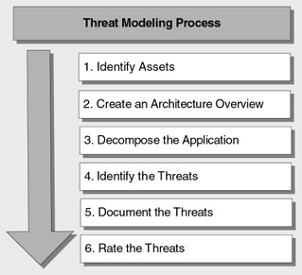
The Threat Modeling Process
Case Study
Paper: Glisson et al. (2015), “Compromising a medical mannequin”
Experiment: Hack mannequin used in medical training environment.
Who?: Undergrad. students at University of South Alabama.
Results: Successful brute force and Denial of Service (DoS) attacks.

Slide 3
1. Identify Assets
What are your most valued assets?
confidential data (compounded by training environment)
possible risk to patients’ lives as a result of incorrect analysis of medical data.
Notes:
The cybersecurity breach could lead to leakage of confidential data and risk patients’ life as a result of incorrect analysis of medical data.
This is compounded when breaches are in medical training environments, causing inaccurate feedback from medical devices. This potentially has much larger and longer lasting effects, impacting innumerous lives due to incorrect analysis of critical data by medical personnel.

Slide 4
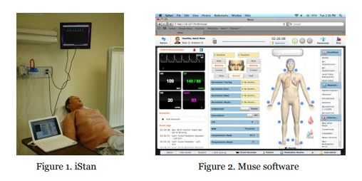
2. Create an Architecture Overview
What components are used to consume the digital asset?
software: Macintosh or Microsoft Windows OS
front-end platform: Adobe Flash Player and Muse software(browser-based)
network protocols: TCP and 802.11 wireless transmissions
Notes:
e iStan Medical Training System software can be implemented on Macintosh or Microsoft Windows operating systems.
The iStan’s front-end platform utilizes Adobe Flash Player and Muse software, which is a browser-based application, to interact with iStan’s profiles.
The network protocols used by the iStan consist of TCP and 802.11 wireless transmissions between the controlling laptops and the iStan’s internal access point.

Slide 5
3. Decompose the application
How many methods are there to consume the digital asset?
Components vulnerable to attack:
The network security
=> breached using an open-source brute force attack against the router Personal Identification Number (PIN).
The network protocol
=> attacked through a denial-of-service attack.

Slide 6
4. Identify the Threats (STRIDE Model)
For each method of access, what are the possible threats?

Slide 7
5. Document the Threats
STRIDE | Compromising a medical mannequin
Spoofing Can an attacker gain access with a false identity? | network security was breached using an open-source brute force attack against the router Personal Identification Number (PIN).
Tampering Can an attacker modify data as it flows through the application? | allowed attacker to trigger incorrect scenarios.
Repudiation If an attacker denies doing something, can we prove he did it? | allowed attackers to act as if they were medical staff.
Information disclosure Can an attacker gain access to private or potentially injurious data? | allowed an attacker to access private data.
Denial of service Can an attacker crash or reduce the availability of the system? | successful Denial of Service (DoS) attack was committed, making the application unavailable.
Elevation of privilege Can an attacker assume the identity of a privileged user? | allowed an attacker to assume the identity of a privileged user, disrupt a session or trigger incorrect scenarios.

Slide 8
6. Rate the Threats (DREAD Model)
Reputation: How high are the stakes? Is there a risk to reputation, which could lead to the loss of customer trust?
Notes:
You can use above items to rate each threat. You can also extend the above questions to meet your needs. For example, you could add a question about potential reputation damage:

Slide 9
High, Medium, and Low Ratings
High
substantial risk
addressed as soon as possible.
Medium
significant risk
addressed, but with less urgency.
Low
some risk
may decide to ignore
Notes:
If a threat is rated as High, it poses a significant risk to your application and needs to be addressed as soon as possible.
Medium threats need to be addressed, but with less urgency.
You may decide to ignore low threats depending upon how much effort and cost is required to address the threat.

Slide 10
Rating the Documented Threats
Rate each threat against the impact to the organization
N. | Threat | D | R | E | A | D | +R | Total | Rating
1 | Network security was breached using an open-source brute force attack against the router PIN | 3 | 3 | 3 | 3 | 3 | 3 | 18 | High
2 | The network protocol was attacked through a denial-of-service attack. | 3 | 2 | 2 | 3 | 3 | 3 | 16 | High
Notes:
damage, reproduce, exploit, affect, discover, reputation

Slide 11
STRIDE Threats and Countermeasures
Threat | Countermeasures
Spoofing user identity | Use strong authentication. Do not store secrets (for example, passwords) in plaintext. Do not pass credentials in plaintext over the wire. Protect authentication cookies with Secure Sockets Layer (SSL).
Tampering with data | Use data hashing and signing. Use digital signatures. Use strong authorization. Use tamper-resistant protocols across communication links. Secure communication links with protocols that provide message integrity.
Repudiation | Create secure audit trails. Use digital signatures.
Information disclosure | Use strong authorization. Use strong encryption. Secure communication links with protocols that provide message confidentiality. Do not store secrets (for example, passwords) in plaintext.
Denial of service | Use resource and bandwidth throttling techniques. Validate and filter input.
Elevation of privilege | Follow the principle of least privilege and use least privileged service accounts to run processes and access resources.

Slide 12
REFERENCES
Threats Modeling | Microsoft Docs
https://docs.microsoft.com/en-us/previous-versions/msp-n-p/ff648644(v=pandp.10)
Threats and Countermeasures | Microsoft Docs
https://docs.microsoft.com/en-us/previous-versions/msp-n-p/ff648641(v=pandp.10)
7 steps to threat modeling| Danny Wong
7stepstothreatmodeling-140421083538-phpapp01.pdf
Compromising a Medical Mannequin| Glisson et. al.
https://arxiv.org/ftp/arxiv/papers/1509/1509.00065.pdf

